Slide 1



Slide 2

BUSINESS ANALYTICS Introduction to Business Analytics and Core Business Functions
BUSINESS ANALYSIS Requirements Documentation

Slide 3
Learning Objectives – WEEK 6
By the end of today you should be able to:
Understand WHY documentation is critical in projects
Differentiate BRD vs SRS vs Agile User Stories
Write basic Use Cases and Acceptance Criteria
Understand Requirement Traceability Matrix (RTM)
Think like an industry Business Analyst

Slide 4
LCLO – WEEK 5
Last week we learned Requirements Elicitation:
✔ Interviews ✔ Workshops ✔ Observation ✔ Brainstorming
👉 Today we convert that information into structured artefacts.

Slide 5
WHY DOCUMENTATION MATTERS?
In real projects:
❌ Verbal agreements cause scope conflict ❌ Developers interpret differently ❌ QA doesn’t know expected behavior
Documentation ensures:
✔ Alignment ✔ Accountability ✔ Traceability
Example
Fintech project:
Client gives feature verbally → Dev builds → Client rejects.
Reason: “No acceptance criteria = no shared definition of success.”
Airbnb feature backlog uses user stories with acceptance criteria → global teams align easily.

Slide 6
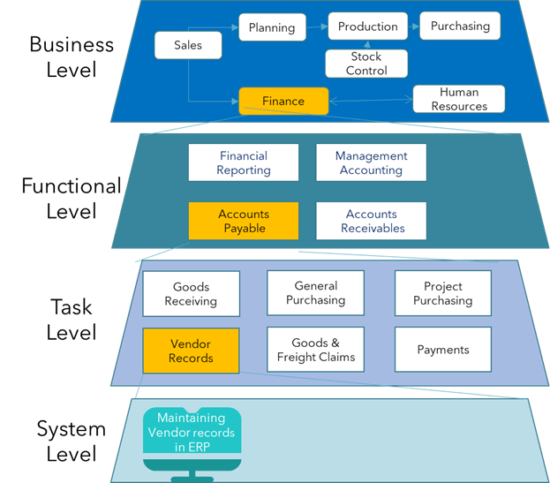
HOW TO DOCUMENT A PROCESS - EXAMPLE

Slide 7
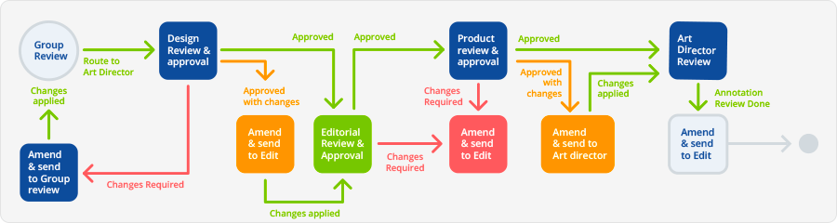
WORKFLOW DOCUMENTTAION AS BA - EXAMPLE

Slide 8
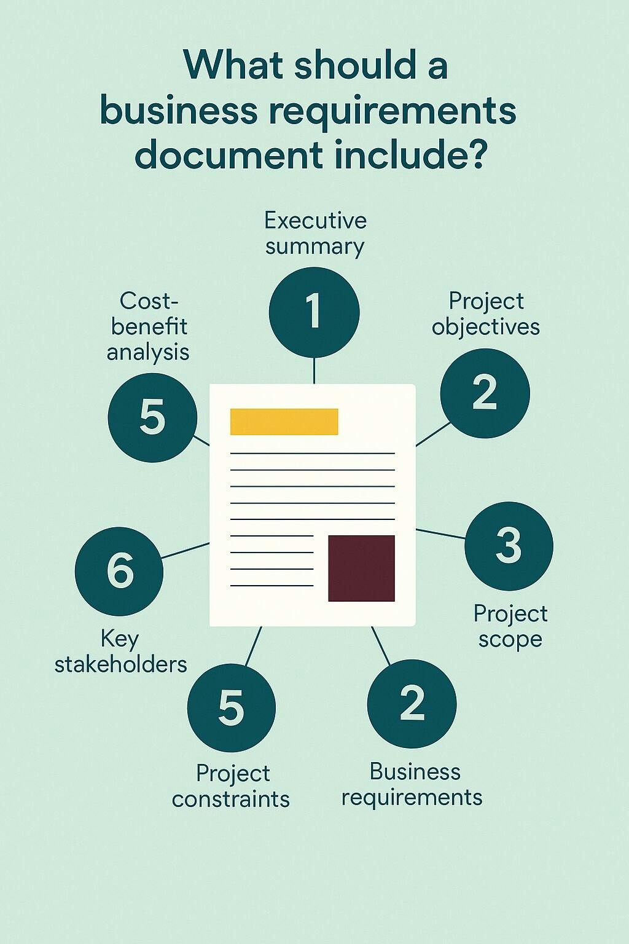
BRD — Business Requirement Document
Purpose
High-level view of:
Business goals
Stakeholders
Problem statement
Scope
Audience:
✔ Executives ✔ Product owners ✔ Clients
Daraz Checkout Optimization - Example
BRD Contains:
Goal: Increase conversion rate
Problem: Cart abandonment
KPI: Reduce drop-off by 20%
“BRD answers WHY — not HOW.”

Slide 9
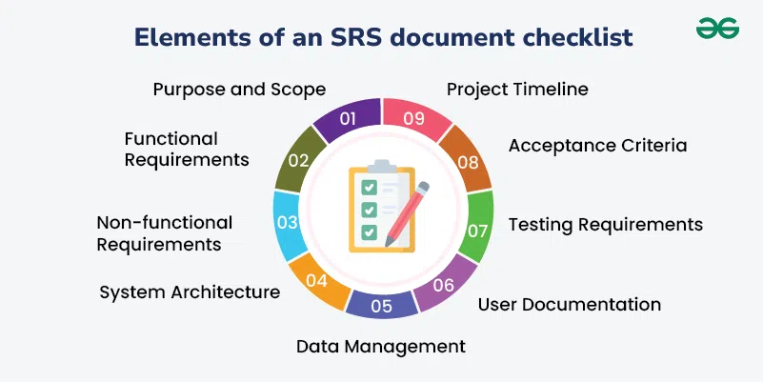
SRS — SOFTWARE REQUIREMENT SPECIFICATION
SRS translates business needs into technical behavior.
Includes:
✔ Functional requirements ✔ Non-functional requirements ✔ System constraints ✔ Data flows
Example — Banking App
Functional: User transfers money.
Non-functional: Response time < 2 seconds.

Slide 10
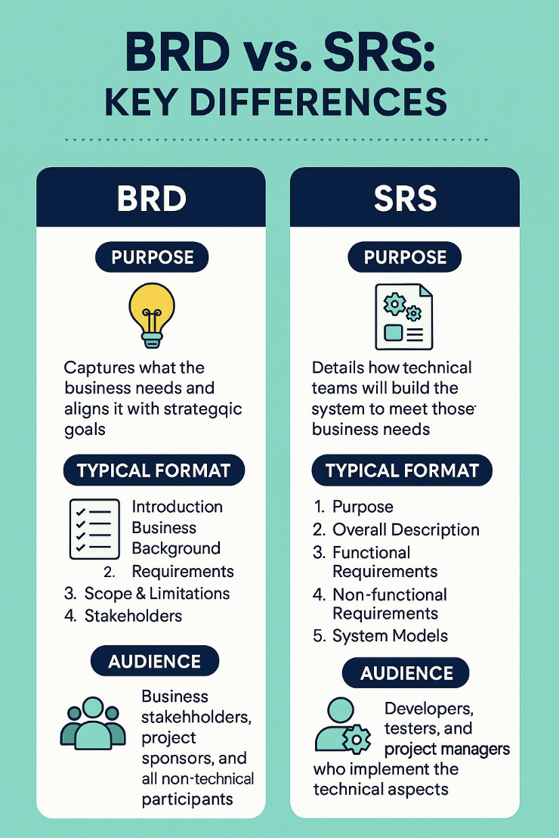

Slide 11
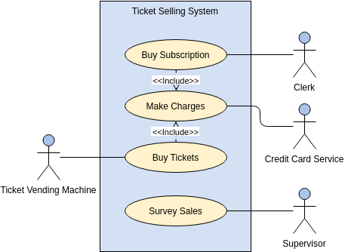
USE CASES
Definition
A Use Case describes interaction between actor and system.
Structure
Actor
Trigger
Steps
Alternate flows
Outcome
Example — Careem Ride Booking
Actor: Customer
Main Flow:
Open app
Enter pickup
Confirm ride
Payment processed
Alternate Flow:
Driver unavailable.
Actor → System → Decision → Outcome
“Use Cases help visualize real behavior — not abstract features.”

Slide 12
USER STORIES (AGILE DOCUMENTATION)
Agile prefers short structured requirements.
Format:
As a [role]
I want [feature]
So that [value]
Example — Grocery App
As a rider I want delivery location navigation So that I deliver faster.
Netflix
As a viewer I want autoplay So that watching feels seamless.
“User Stories emphasize user value, not system design.”

Slide 13
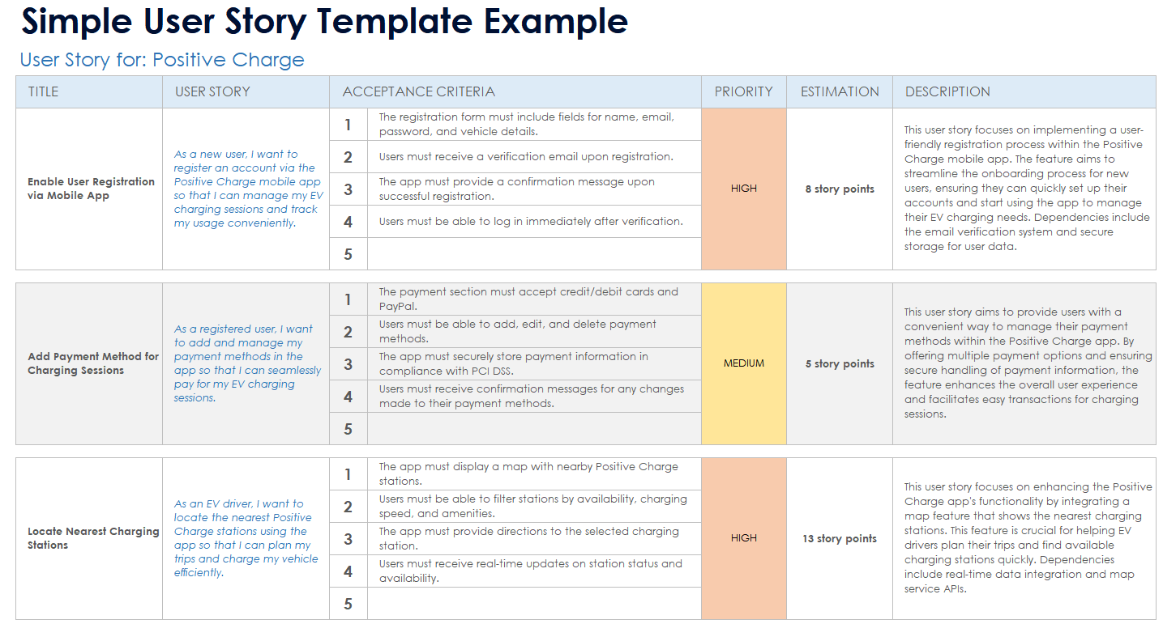

Slide 14
ACCEPTANCE CRITERIA (VERY CRITICAL CONCEPT)
Acceptance Criteria = testable conditions defining success.
Good Example
User Story: As a customer I want fast checkout.
Acceptance Criteria:
✔ Checkout within 3 clicks ✔ Payment success message displayed ✔ Order ID generated
Bad Example
“System should be user friendly.” Ambiguous:
No measurement = no validation.

Slide 15
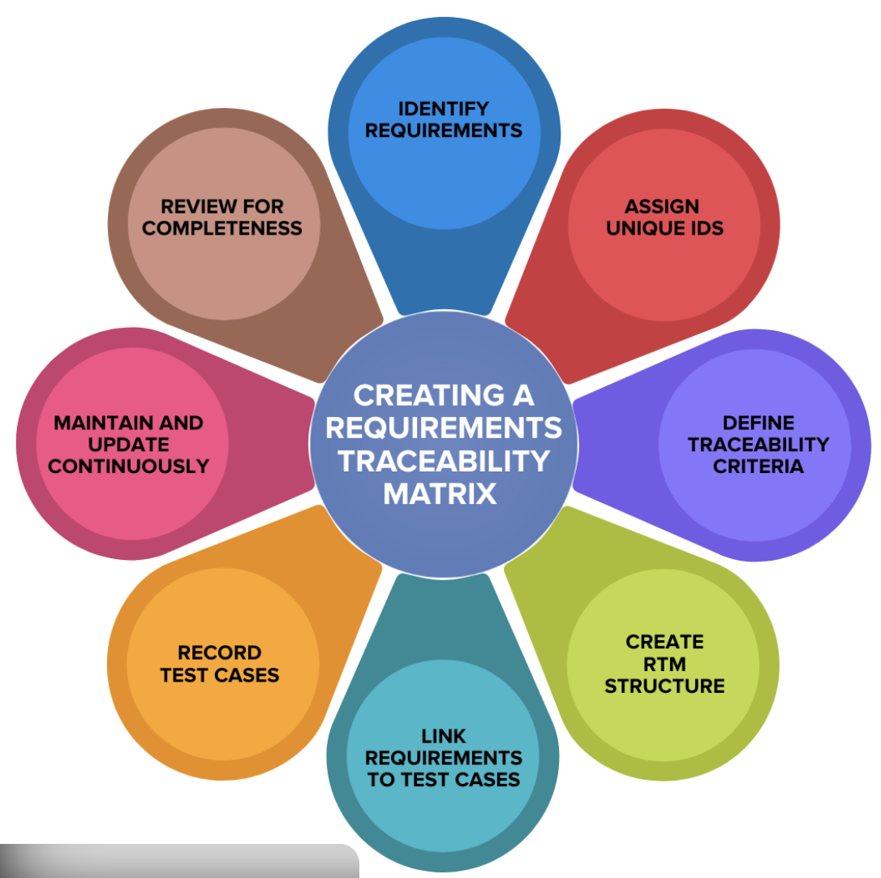
REQUIREMENT TRACEABILITY MATRIX (RTM)
Business Goal → Requirement → Design → Development → Test Case
Purpose:
✔ Track scope ✔ Prevent missing features ✔ Help QA validation
Example — Banking Login Feature
Goal: Secure access.
Requirement: OTP login.
Test Case: Verify OTP expires in 30 sec.
“RTM protects BAs during scope disputes.”

Slide 16
COMMON STUDENT MISTAKES
❌ Writing solutions instead of requirements ❌ Mixing business and functional levels ❌ Writing acceptance criteria like descriptions
Requirements must be:
✔ Specific ✔ Measurable ✔ Testable

Slide 17
REAL LIFE FLOW
BRD
↑
Use Case
↑
User Story
↑
Acceptance Criteria
Big picture
Interaction
Value
Precision
Think of documentation like zooming into detail.
Use Case vs User Story:
Use Case | User Story
Detailed steps | Short description
Traditional projects | Agile projects
Formal structure | Flexible format
“Large enterprises still use Use Cases — startups often rely on User Stories.”

Slide 18
KEY TAKEAWAYS
✔ Documentation prevents misunderstandings ✔ BRD explains business vision ✔ SRS explains system behavior ✔ User Stories drive Agile teams/deliveries ✔ Acceptance Criteria define done/success ✔ RTM ensures traceability = nothing lost
“Documentation is not paperwork — it is shared understanding.”

Slide 19
CASE STUDY
Choose one:
Careem
Daraz
WhatsApp
Create:
✔ 1 Use Case ✔ 2 User Stories ✔ Acceptance Criteria ✔ Simple RTM table

Slide 20
“Many escalations I’ve handled happened because acceptance criteria were missing.”
“Developers don’t need long documents — they need clear expectations.”
“Traceability becomes critical when projects scale.”

